Slide 1
Loss function
Error

Slide 2
What are Loss Functions?
Let’s say you are on the top of a hill and need to climb down. How do you decide where to walk towards?
Look around to see all the possible paths
Reject the ones going up. This is because these paths would actually cost me more energy and make my task even more difficult
Finally, take the path that think has the most slope downhill

Slide 3
What are Loss Functions?
In supervised machine learning algorithms, we want to minimize the error for each training example during the learning process. This is done using some optimization strategies like gradient descent. And this error comes from the loss function.

Slide 4
Difference between a Loss Function and a Cost Function?
A loss function is for a single training example.
It is also sometimes called an error function.
A cost function, on the other hand, is the average loss over the entire training dataset.
The optimization strategies aim at minimizing the cost function.

Slide 5
Loss Function
Regression Loss Functions
Squared Error Loss
Absolute Error Loss
Huber Loss
Binary Classification Loss Functions
Binary Cross-Entropy
Hinge Loss
Multi-class Classification Loss Functions
Multi-class Cross Entropy Loss
Kullback Leibler Divergence Loss

Slide 6

Regression Loss Functions
Squared Error Loss
Squared Error loss for each training example, also known as L2 Loss, is the square of the difference between the actual and the predicted values:
The corresponding cost function is the Mean of these Squared Errors (MSE).

Slide 7

Regression Loss Functions
Absolute Error Loss
Absolute Error for each training example is the distance between the predicted and the actual values, irrespective of the sign. Absolute Error is also known as the L1 loss:
The corresponding cost function is the Mean of these Absolute Errors (MAE).
The MAE loss is more robust to outliers as compared to MSE.

Slide 8
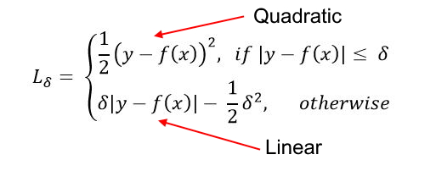
Regression Loss Functions
Huber Loss
The Huber loss combines the best properties of MSE and MAE. It is quadratic for smaller errors and is linear otherwise (and similarly for its gradient). It is identified by its delta parameter:
It is used in Robust Regression, M-estimation and Additive Modelling. A variant of Huber Loss is also used in classification.
The Huber loss is more robust to outliers as compared to MSE.

Slide 9
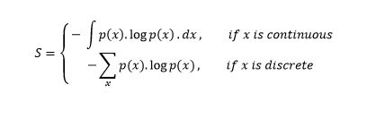
Binary Classification Loss Functions
Binary Cross Entropy Loss
A greater value of entropy for a probability distribution indicates a greater uncertainty in the distribution. Likewise, a smaller value indicates a more certain distribution.
Entropy

Slide 10


Binary Classification Loss Functions
Binary Cross Entropy Loss
This is also called Log-Loss. To calculate the probability p, we can use the sigmoid function. Here, z is a function of our input features:
The range of the sigmoid function is [0, 1] which makes it suitable for calculating probability.

Slide 11
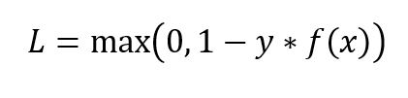
Binary Classification Loss Functions
Hinge Loss
Hinge loss is primarily used with Support Vector Machine (SVM) Classifiers with class labels -1 and 1. Entropy.
Hinge loss for an input-output pair (x, y) is given as:
Hinge Loss not only penalizes the wrong predictions but also the right predictions that are not confident.

Slide 12
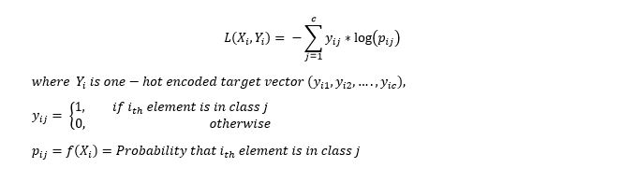
Multi-Class Classification Loss Functions
Multi-Class Cross Entropy Loss
The multi-class cross-entropy loss is a generalization of the Binary Cross Entropy loss. The loss for input vector X_i and the corresponding one-hot encoded target vector Y_i is:

Slide 13
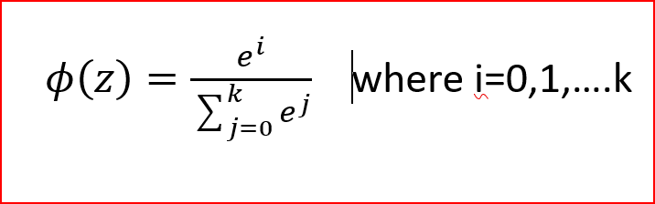
Multi-Class Classification Loss Functions
We use the softmax function to find the probabilities p_ij:
“Softmax is implemented through a neural network layer just before the output layer. The Softmax layer must have the same number of nodes as the output layer.” Google Developer’s Blog

Slide 14
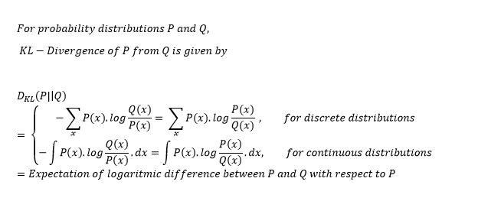
Multi-Class Classification Loss Functions
Kullback-Liebler Divergence is a measure of how a probability distribution differs from another distribution. A KL-divergence of zero indicates that the distributions are identical.
KL-Divergence is used more commonly to approximate complex functions than in multi-class classification.

